Slide 1

Section 10-3
Using Permutations and Combinations
Solve counting problems involving permutations and the fundamental counting principle.
Solve counting problems involving combinations and the fundamental counting principle.
Solve counting problems that require whether to use permutations or combinations.

Slide 2
Permutations
In the context of counting problems, arrangements are often called permutations
The number of permutations of n things taken r at a time is denoted _{n}P_{r}.
For example, the number of permutations of 6 things taken 4 at a time would be ₆P₄ , which is calculated as: 6 ∙ 5 ∙ 4 ∙ 3 = 360

Slide 3
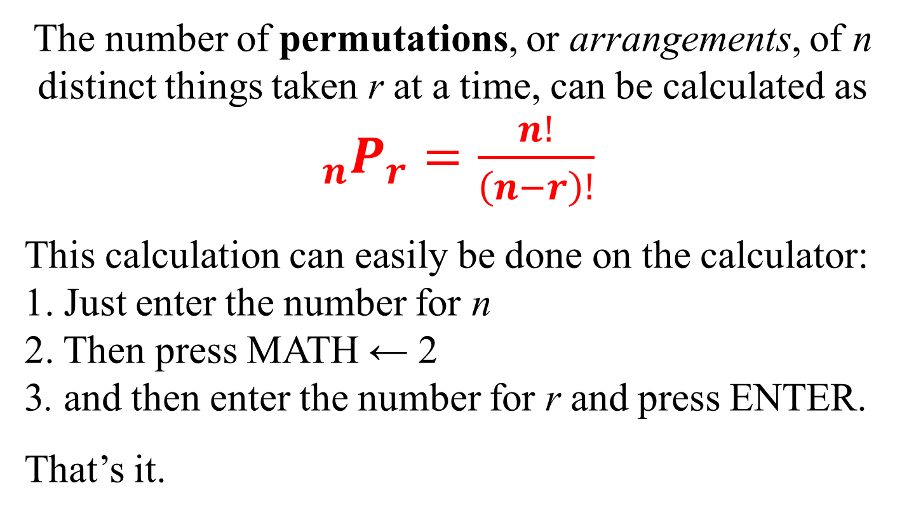
Factorial Formula for Permutations
Order matters!
The number of permutations, or arrangements, of n distinct things taken r at a time, can be calculated as $_{n}P_{r}=\frac{n!}{\left(n−r\right)!}$
This calculation can easily be done on the calculator: 1. Just enter the number for n 2. Then press MATH ← 2 3. and then enter the number for r and press ENTER.
That’s it.

Slide 4
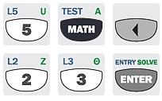
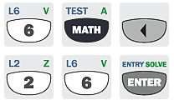


Example: Using the Factorial Formula for Permutations
Evaluate each permutation.
a) ₅P₃ b) ₆P₆
Solution
Solution

Slide 5
Example: IDs
How many ways can you select two letters followed by three digits for an ID if repeats are not allowed?
Solution
There are two parts:
1. Determine the set of two letters.
2. Determine the set of three digits.
Part 1
Part 2

Slide 6

Example: Building Numbers From a Set of Digits
How many four-digit numbers can be written using the numbers from the set {1, 3, 5, 7, 9} if repetitions (repeated digits) are not allowed?
Solution
Repetitions are not allowed and order is important (the number 1357 is different than the number 1537, for example), so we use permutations.
n = 5 (the total choices available), r = 4 (a 4-digit number)
₅P₄ = 120
So there are 120 different 4-digit numbers with no repetitions.

Slide 7
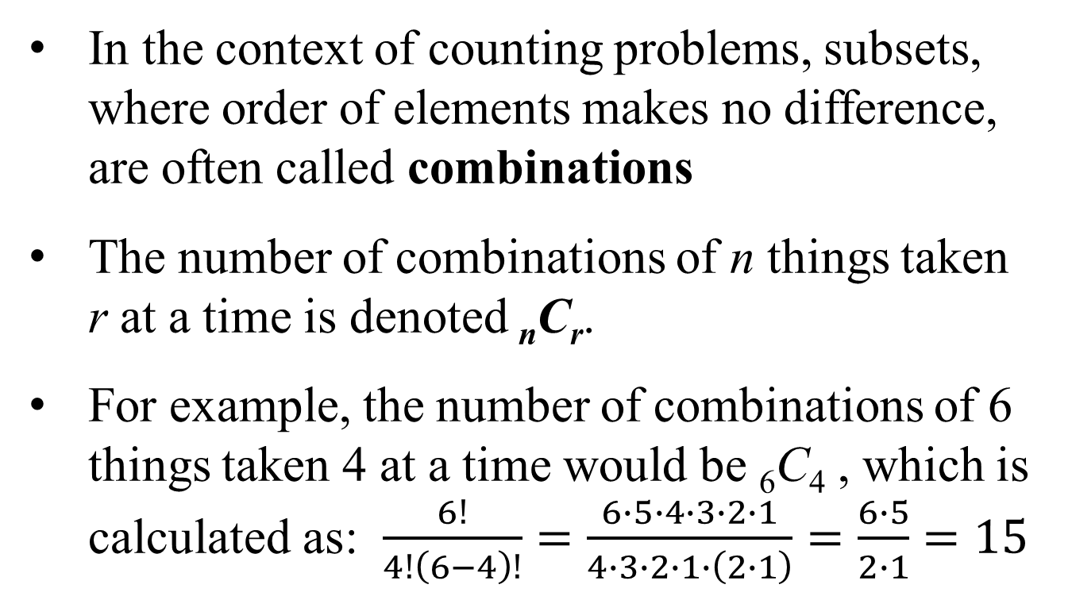
Combinations
In the context of counting problems, subsets, where order of elements makes no difference, are often called combinations
The number of combinations of n things taken r at a time is denoted _{n}C_{r}.
For example, the number of combinations of 6 things taken 4 at a time would be ₆C₄ , which is calculated as: $\frac{6!}{4!\left(6−4\right)!}=\frac{6∙5∙4∙3∙2∙1}{4∙3∙2∙1∙\left(2∙1\right)}=\frac{6∙5}{2∙1}=15$

Slide 8
Factorial Formula for Combinations
Order doesn’t matter!
The number of combinations, or subsets, of n distinct things taken r at a time, where r n, can be calculated as
This calculation can easily be done on the calculator: 1. Just enter the number for n 2. Then press MATH ← 3 3. and then enter the number for r and press ENTER.
That’s it.

Slide 9
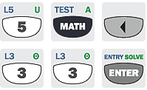
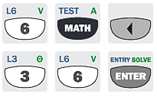

Example: Using the Factorial Formula for Combinations
Evaluate each combination.
a) ₅C₃ b) ₆C₆
Solution
Solution

Slide 10
Example: Finding the Number of Subsets
Find the number of different subsets of size 3 in the set {m, a, t, h, r, o, c, k, s}.
9 total letters, so n = 9. Subset size 3 means r = 3.
Solution
A subset of size 3 must have 3 distinct elements, so repetitions are not allowed. Order is not important.
₉C₃ = 84
So there are 84 different subsets of size 3 in the set {m, a, t, h, r, o, c, k, s}.

Slide 11
Example: Finding the Number of Subsets
A common form of poker involves hands (sets) of five cards each, dealt from a deck consisting of 52 different cards. How many different 5-card hands are possible?
Solution
Repetitions are not allowed and order is not important.
₅₂C₅ = 2,598,960

Slide 12
Guidelines on Which Method to Use
Permutations | Combinations
Number of ways of selecting r items out of n items
Repetitions are not allowed
Order is important. | Order is not important.
Arrangements of n items taken r at a time | Subsets of n items taken r at a time
_{n}P_{r} = n!/(n – r)! | _{n}C_{r} = n!/[ r!(n – r)!]
Clue words: arrangement, schedule, order | Clue words: group, sample, selection, committee, team

Slide 13
Sample Problem from MML
An electronics store receives a shipment of 20 graphing calculators, including 8 that are defective. Four of the calculators are selected to be sent to a local high school. How many of these selections will contain no defective calculators?
Solution
20 calculators – 8 defective = 12 non-defective
4 are to be sent, and order doesn’t matter.
So use ₁₂C₄ = 495 There are 495 ways to send 4 non-defective calculators.

Slide 14
Sample Problem from MML
To win at LOTTO in one state, one must correctly select 8 numbers from a collection of 64 numbers (1 through 64). The order in which the selection is made does not matter. How many different selections are possible?
Solution
Since order doesn’t matter, we use ₆₄C₈ = 4,426,165,368
So, there are 4,426,165,368 different ways to select 8 separate numbers from the numbers 1 through 64.

Slide 15
Sample Problem from MML
Television and radio stations use four call letters starting with W or K, such as WXYZ or KRLD. Assuming no repetitions in the second to fourth letters, how many four-letter sets are possible using either W or K and only the letters C to P? (Count all possibilities even though, practically, some may be inappropriate.)
Solution
1st letter has 2 choices, W or K. 2nd – 4th letters is a permutation, because no repetitions and order matters. The letters C to P are 10 total, so use ₁₄P₃ = 2184 ways to arrange remaining 3 letters. So, 2 ∙ 2184 = 4368.
There are 4368 distinct four-letter sets that can be formed.

Slide 16
Sample Problem from MML
A baseball team has 6 pitchers, who only pitch, and 11 other players, all of whom can play any other position except pitcher. For Saturday’s game, the coach has not yet determined which 9 players to use, nor what the batting order will be, except that the pitcher will bat last. How many different batting orders may occur?
Solution
First, account for the pitcher batting last: there are 6 ways for that.
That means there are 8 remaining positions in the batting order to be filled from 11 players. Since repetition is not allowed and order matters, use permutation ₁₁P₈ = 6,652,800. So, a total of
6,652,800 ∙ 6 = 39,916,800 different batting orders possible.

Slide 17
Sample Problem from MML
In how many ways could 18 people be divided into five groups containing, respectively, 1, 2, 3, 4, and 8 people?
Solution With “groups,” repetitions are not allowed and order is not important – use combinations.
Group of 1: ₁₈C₁ = 18 with 17 left to put in groups.
Group of 2: ₁₇C₂ = 136 with 15 left to put in groups.
Group of 3: ₁₅C₃ = 455 with 12 left to put in groups.
Group of 4: ₁₂C₄ = 495 with 8 left to put in a group.
Group of 8: ₈C₈ = 1 Now multiply all together:
(18)(136)(455)(495)(1) = 551,350,800
The groups can be chosen in 551,350,800 ways.

